Slide 1

Katz Pharmacy Services Incorporated
Preliminary Change Readiness
Assessment Report
DRAFT
May 21st, 2003

Slide 2

Change Readiness Assessment Report
Change Readiness Assessment Overview
Findings
Recommended Initiatives
deeper
focus
Are You Ready?

Slide 3
The results and recommendations included in this change readiness report were generated by completing a series of steps from information gathering to analysis
The goal of the change readiness assessment is to understand and document the scope and magnitude of change required by key internal and external stakeholders and assess their likely willingness and ability to implement change.
Approach taken
Interviews Completed
Conduct Interviews
Peter Davidson
Mike Martin
Mike Jaczko
Grant Schwartz
Terry Buckley
Lisa Harrison
Bruce Moody
Cary Rendek
Rui Martins
John Ford
Paul Barrett
Document and
Synthesize Information
Assess against Critical Success Factors
Analyze Results
Recommend Initiatives to Mitigate Risks
April 25th
May 23rd

Slide 4
Using this approach to understand the impact of change is important because supply chain driven transformations are complex undertakings, that will stress Katz’s ability to manage and implement change.
Katz will experience some reduction in productivity; but the degree to which productivity drops, and the duration of time in which it remains low is directly correlated with its ability to manage the change effectively.
Initiatives have been identified at the end of this report to help Katz execute well coordinated change.
High
Well
Coordinated Change
“Change management is the hardest part of any of this... It dwarfs everything else”
Michael Hammer
co-author: Re-engineering the Corporation
Poorly
Coordinated Change
Performance
Uncoordinated Change
Low
Project Lifecycle (Time) ------>

Slide 5

Change Readiness Assessment Report
Change Readiness Assessment Overview
Findings
Recommended Initiatives
deeper
insight
Findings

Slide 6
During the change readiness assessment, several positive factors were found to exist that Katz can use to manage and support the supply chain project going forward
The need for change is understood
Perception is that doing nothing could impact the potential to manage growth in the future
Project leadership is perceived as very knowledgeable and committed
There is an eagerness to bring more value to the customer experience
History shows that there is a propensity and tolerance for change as a means to an end
The senior leadership team is perceived as being driven, proactive, and results oriented
A communications resource has been assigned to the project

Slide 7
Also during the assessment, stakeholders were mapped to help us begin to understand the role that each group would hold in the project
Stakeholder Group and Associated Roles
Set Change Direction
Deliver Change
Steering Committee
  Change Leader
B) Extended Project Team
  Change Agent
C) Other Executives and Directors
  Change Influencer and Agent
D) Corporate Stores
  Change Target
E) Independent Stores
  Change Target
F) IT
  Change Influencer, Agent, and Target
G) McKesson
  Change Customer
Customer
(Internal or
External)
Recipient of the change benefits whose views must be considered but does not authorise or participate in change
Facilitator/ implementer responsible for achieving change and has a contract with a change leader
Change
Agent
Lead Change
Change
Leader
Leader who demands and authorises change
Client staff who must change for benefits to be delivered
Influencer
Supporter and influencer who sometimes initiates change but cannot lead it
Change
Target
Stakeholders can and do change roles over the course of the change project
Stakeholders can play more than one role at a time during a change project

Slide 8
We found that given the groups in the identified roles, there is currently a gap between where each Stakeholder group is today and where they should be in terms of their willingness and capability to support the project going forward
High
Influence on Project Direction and Success
G
A
G
A
C
C
Medium
F
F
E
B
E
B
D
D
Low
1 2 3 4 5 6 7 8 9
Low: ‘Unconvinced’
Medium: ‘On-the fence’
High: ‘Champion’
Willingness and Capability to Support the Project
Back to routemap

Slide 9
Using the stakeholder map and interview results, findings were clustered into four issue areas that could pose the greatest potential risk to the success of the project going forward
1) Clarity of Direction
  The degree of alignment and understanding of the scope and impact of this project amongst senior leaders.
Degree of Risk to Project:
2) Targeted and Effective Communications
  The extent that two-way structured communication is used as a vehicle to increase the commitment level of each stakeholder group.
Degree of Risk to Project:
3) Measurements and Rewards
  The availability and acceptance of performance measurement and reward systems to reinforce and support the organization, roles, and skill changes required for the project.
Degree of Risk to Project:
4) Cultural Diversity
  The existence of common and well understood cultural attributes that align with, and support, the overall corporate and project vision.
Degree of Risk to Project:
L M H
L M H
L M H
L M H

Slide 10
Lack of a common vision and senior leadership alignment around the project scope will cause a risk that Katz will not adopt the rigor required to support the project
1) Clarity of Direction
Key Issues:
  Fragmented senior leadership alignment around project scope
    Steering Committee is perceived as being committed, yet have not had the opportunity to begin extensive communication of project vision to the rest of the organization
  Inconsistent understanding of whether project is a business or IT initiative
  No wide-spread understanding of the full potential of a supply chain solution or it’s role in supporting business strategies
  Uncertainty over role of McKesson in the project
Risks to the Project
    There is a risk that the organization will not adopt the rigor required to support an integrated business system if there is not active and ongoing alignment around the new mode of operations
      people are used to operating in ‘islands of excellence’ … trying to do a great job but in isolation
      people will default to their old tools and techniques if there is no clear evidence that the new operational model will be rigorously enforced
    Uncertainty over McKesson role will create confusion when design begins

Slide 11
A common vision that provides clarity and direction is necessary for the project and Katz as an organization to enable stakeholders to execute the strategy
Levels of Vision
STRATEGY
Core Vision
Principal Stakeholder Appeal
Senior Leadership
Extended Project Team
Everyone
How should this business compete?
Full Scope Vision
What is the full scope of change required?
Operational Vision
What does this mean for us/me?
REALITY
If you cry “forward”, you must make clear the direction you want to go. Don’t you see that if you fail to do that and simply call out the word to a monk and a revolutionary, they will go precisely in the opposite directions.
Antov Chekhov

Slide 12
Although communications is being enabled by the presence of a coordinator today, the structure and foundation for communication within Katz does not currently exist that will impede the stakeholders ability to become willing change participants
2) Targeted and Effective Communications
Key Issues:
  History of disconnects in communication from senior leaders
  Lack of enterprise-wide standards and expectations for delivery of communication
  Internal Communication vehicles exist but are under-utilized
  Uncertain expectations of roles and responsibilities of the project team members
  Common vision has not been well communicated
Risks to the Project:
    Lack of key stakeholder commitment to the “case for change” will not be well understood if a structure for communication does not exist.
    Expectations at the store level will not be set or met.
    Key stakeholders will not be prepared and may resist the change required.

Slide 13
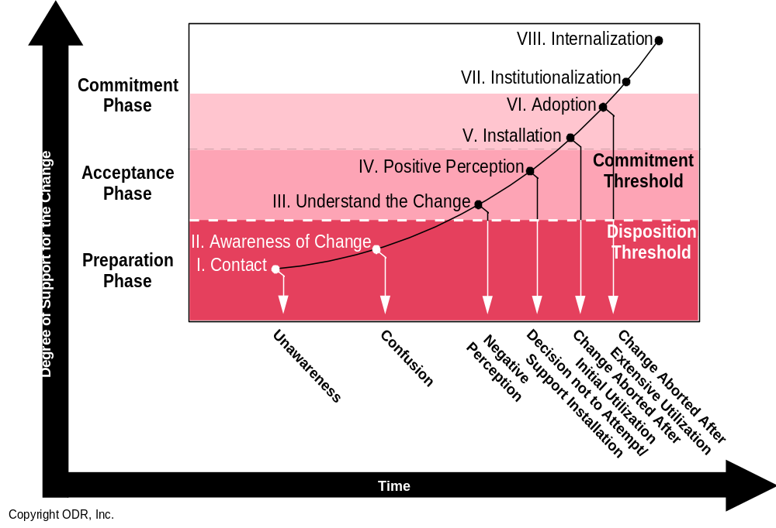
The establishment of a standard communication structure that addresses the needs of the various stakeholders is critical to gain commitment and buy-in and remove negative perceptions that will impede the progress of change
Katz is Here

Slide 14
Inconsistent performance metrics and measurements will impact negatively on the projects timeline and ability to maintain key resources
3) Measurements and Rewards
Key Issues:
  Lack of a structured performance measurement program
  Inconsistent performance environment
      Incentives and recognition programs
      Process structure
      Skills and tools
  Poor understanding of current skill levels as they relate to supply chain processes
  Limited exposure to incentives for project-based resources
Risks to the Project
    The project will lose momentum and focus as resources will be confused
    The progress of the project will slow down as resources, especially on the core team, will take more time to move up the learning curve on their own
    Without clear measurements there will be a tendency to push resources beyond their capabilities causing stress and burn-out of key resources
    Motivation will falter and there will be a high turnover of key resources on the project

Slide 15
Katz will need to move up the performance maturity level from Ad-hoc to ensure there is reinforcement for the new measurements, skills and learning required to support the project
Adaptive
Continuous improvement of the performance process is enabled by feedback and measurement of the process and from piloting innovative ideas and technologies. Success is the norm. Quality, outcome, cost and schedule performance is continuously improving.
Managed
Detailed measures of the effectiveness of performance interventions are collected and used by management. The process is understood and controlled. Success is more uniform. Quality, desired outcomes, cost and schedule conforms to plan.
Organized
Performance processes, systems and measurements are documented, standardized, and integrated into an end-to-end process. Success is more predictable. Quality, desired outcomes, and cost and schedule performance is improved.
Abbreviated
Some performance systems processes and measurements are established to track progress. Underlying disciplines, however, are not well understood or consistently followed. There is a lack of desired outcomes, cost overruns and schedule problems are the norm.
Ad-Hoc
Performance process is described as disorganized, and occasionally even chaotic. Systems, processes and measurements are not defined. Success depends on individual effort. Chronic quality, desired outcome, cost and schedule problems.

Slide 16
Lack of a cohesive desired culture at Katz will reduce the effectiveness of the improvements and efficiencies expected in the short and long term
4) Cultural Diversity
Key Issues:
  Cultural disparities lingering from transition
  Common voice and vision is not well articulated
  Cross-functional integrated team work is not the norm
  Common norms and values are not well understood
Risks to the Project
  Failure to break down the existing cultural barriers will
    add complexity to the implementation project
      If the silo mentality cannot be overcome in the development of the solution the implementation timeline Katz resource requirements may be put at risk
    put the ability to achieve the full value of an integrated solution at risk
    put the ability to leverage the supply chain solution as the foundation for growth at risk
    increase the long term cost of ownership and add complexity to future support and upgrades
  Risk that existing systems will not be ‘decommissioned’
    If units are not appropriately engaged to participate in enterprise-wide solutions there is a risk that functions in existing systems resist the migration to a common solution

Slide 17
Establishing cultural alignment with the strategy is necessary to maintain stakeholder participation in the project
Strong
Culture resists
strategy
Organisation not aligned
with strategy
Project will receive opposition
Culture reinforces
strategy
Organisation strongly aligned with strategy
Project will be embraced
Desired
Culture Alignment Strength
Culture not relevant to direction of strategy
Organisation drifts
away from strategic goals
Project will diffuse and lose focus
Culture not relevant to direction of strategy
Organisation is unfocused
Project will under-deliver
Current
Weak
Low
Fit with strategy/ change program
High

Slide 18
The readiness for change will be enhanced by leveraging Katz’s key enablers and reducing the impact of key issues found during the change readiness assessment
Key Enablers
Doing Nothing is Not an Option
Knowledgeable and Driven Project Leadership
Customer-driven Need for Change
Propensity and Tolerance for Change
Key Issues
Clarity of Direction
Targeted and Effective Communications
Measurements and Rewards
Cultural Diversity
Readiness for Change

Slide 19

Change Readiness Assessment Report
Change Readiness Assessment Approach
Findings
Recommended Initiatives
deeper
capabilities
Recommended Initiatives

Slide 20

To mitigate the change management risks, actions have been clustered into five recommended initiatives that include the establishment of a Change Lead to manage overall design, development, and implementation of all change initiatives in a consistent and cohesive manner
Initiatives
A. Change Lead
B. Communication Strategy and Plan
Approach: Identify communication lead, key stakeholder communication needs, develop two-way communication plan, create messages, deliver key messages
C. Performance Management Support
Approach: Define new performance management requirements and skill gaps
D. Leadership Alignment
Approach: Identify strategic levers to cohesively cascade project vision and strategy throughout Katz.
E. Team Building
Approach: Identify team charter, desired norms and values, develop team effectiveness survey and distribute periodically
Mitigating Actions

Slide 21
The existence of a change lead is recommended to effectively manage overall design, development, and implementation of all change initiatives in a consistent and cohesive manner.
A. Change Lead
Purpose: The purpose of the change lead is to coach the change agents, represent and articulate the project vision and managing of all change initiatives across Katz.
Staffing Roles: The change team lead will be responsible for one or more initiatives; planning and managing the activities required to complete initiatives within specified timeframe; work closely with each area; identify and communicate change issues and risks; participate in bi-weekly status updates; delegate activities, where required to other team leads. The estimated number of resources includes one 50% Change Leader; one to two 20-25% team members.
Timeframe: Start at the earliest and maintain for the duration of the implementation
Benefits: The change lead will ensure improvement in the overall comfort and readiness for change by cohesively delivering consistent project messages across Katz; facilitating leadership alignment activities, ensuring equity in the delivery of communication and organizational changes.

Slide 22
A comprehensive communication strategy and plan should be created with specific messages targeted to the commitment level of each stakeholder group according to key milestone dates
B. Communication Strategy and Plan
Purpose: The purpose of the communication strategy and plan is to define the strategies and mechanisms for effective two-way communication within and outside of the project to ensure that the right messages are delivered at the right time to the right stakeholders in the right manner.
Staffing Roles: There are two roles associated with this initiative. Initially, the communications lead will be responsible for designing the strategy and plan that will include the key messages, preferred delivery methods, timing, and feedback mechanism, by stakeholder group. The second role involves 20% of time to coordinating the development of the communication message, delivery of the message, receiving feedback about it’s effectiveness, and improving the overall plan, based upon feedback.
Timeframe: The communication strategy can begin once there is commitment to proceed with the next phase, and would generally take 3-4 weeks to complete. Once completed, the communication coordination would continue until the end of each stage, at which time the communication strategy will need to be re-defined/validated for subsequent stages.
Benefits: The communication plan will identify the key messages required to enable buy-in. Having a clear communication strategy and plan will improve awareness and acceptance of the project vision and objectives to minimize the rumor-mill.

Slide 23
Targeted performance support is recommended to begin socializing the stakeholders and rewarding them for desired cross-functional teaming, and increase their level of comfort around the new supply chain process
C. Performance Management Support
Purpose: The purpose of the performance management support initiative is to identify key performance measurements; define new roles and responsibilities; map the skills required to support the stakeholder groups who will be impacted by the implementation; and build a high level training strategy. This will serve as input to the end user training strategy and plan required for the implementation of Casper.
Staffing Roles: There is one core role for this initiative which includes a resource who is responsible for taking the desired skills and performance and working with each impacted organization to understand current roles and responsibilities and build a Training strategy and plan to address performance related gaps. The estimate for resources includes one 25% performance management lead.
Timeframe: This initiative should begin once the current and future state has been defined, and the organizational impacts and gaps identified. The anticipated duration is unknown at this time.
Benefits: The performance management support initiative will enable the knowledge of new capabilities and associated performance measurements required for process and -centric thinking required to achieve the vision. Identification of skill requirements will provide greater depth to the training strategy and plan and enable an improvement in overall comfort and readiness for change.

Slide 24
Leadership alignment efforts will focus on creating an environment where everyone is ready, willing, and able to be creative, take initiative, and provide necessary support for the project
D. Leadership Alignment
Purpose: The purpose of the leadership alignment initiative is to use a survey and workshop setting to help leaders address strategic levers to cohesively cascade the project vision and strategy throughout their respective units.
Staffing Roles: There is one core role for this initiative which includes a lead resource who is responsible for executing the survey and facilitating the workshop. They will then be responsible for monitoring results and meeting with senior management periodically to coach ongoing progress. The estimate for resource includes one 5% of time throughout the duration of the project.
Timeframe: This initiative should begin upon completion of the executive visioning session, prior to the implementation phase.
Benefits: The leadership development initiative will enable senior leaders to focus actions to support the project implementation at a strategic and operational level enough to produce measurable results and add value to the project.

Slide 25
Team building, as an initiative, would include the identification and execution of activities to establish common norms and values to enable key stakeholders to work together more effectively
E. Team Building
Purpose: The purpose of the team building initiative is to develop a cohesive team charter that consists of desired team norms, values, and assessment tools to monitor team progress. This will serve to reinforce the overall cohesive culture of Katz.
Staffing Roles: The teams will be involved in an initial workshop to identify desired norms, values and working relationships, and will create a plan for monitoring team progress. A team building lead will be responsible for executing the plan and providing feedback during status meetings. The estimated number of resources required will be key stakeholders for one half day. In addition, the team building lead will require approximately 5% of time throughout the duration of the project.
Timeframe: The initial workshop should ideally take place prior to full fledged commitment to implementation. Execution of the plan will take place over the duration of the project, especially implementation.
Benefits: The team building initiative will improve readiness for integrated execution by identifying realistic stakeholder expectations and providing guiding principles by which team members will interact and represent Casper.

Slide 26
Using a high level timeline, the plan suggests that some of the initiatives begin almost immediately, based upon their priority and ability to maximize benefit and overall effectiveness
C. Performance Management Support
D. Leadership Alignment
B. Communication Strategy and Plan
E. Team Building
A. Change Lead
Timeline
2nd Qtr 2003
3rd Qtr 2003
4th Qtr 2003
1st Qtr 2004
2nd Qtr 2004
3rd Qtr 2004

